Slide 1

Rules of Handicapping
Carolinas GHIN Support
Fall Series Seminars
Notes:
Please use this title slide if you do not plan to co-brand it.
Welcome and Introductions
• Welcome everyone
• Introduce yourself and the other instructors if applicable
• Invite attendees to ask questions.

Slide 2
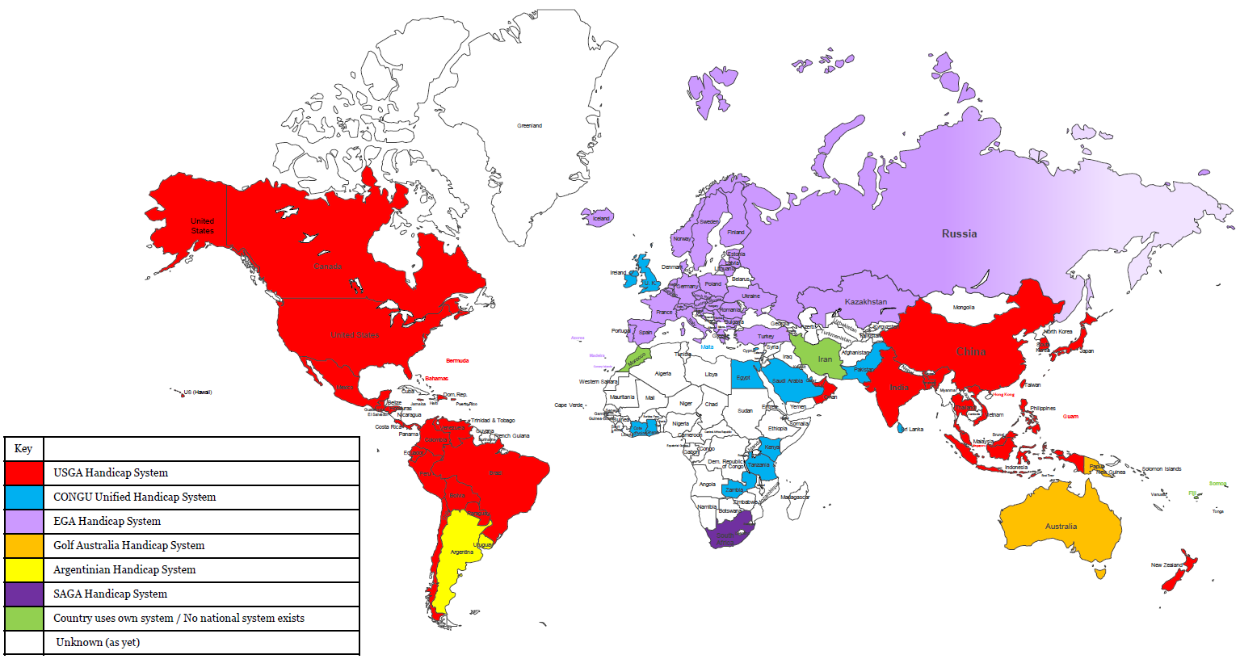

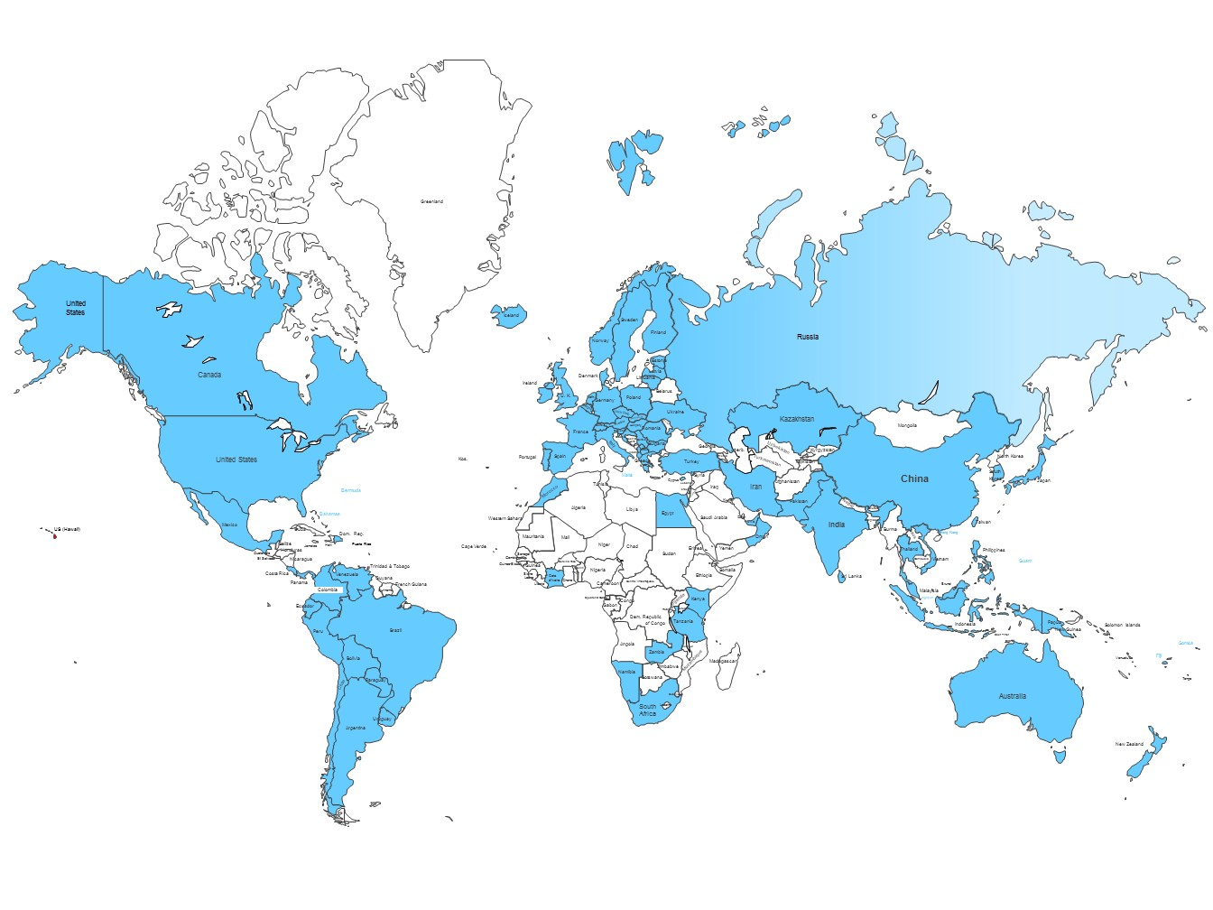





Six Systems to One
Notes:
Current landscape
You can see by the map that the USGA Handicap System is the primary system being used today around the world. There are six systems representing 80 countries. Each system aims to achieve the same thing – measure a golfer’s ability and provide equity for play – but with differing results that don’t translate very well from one to the other.
A collaborative process – USGA, R&A, Council of National Golf Unions (CONGU), European Golf Association, Golf Australia, Argentine Golf, South African Golf. Each of the existing handicap authorities have representation on the World Handicap Operations Committee. Along with the World Handicap Board, they've helped developed the new World Handicap System.
Future landscape (2020)
A unified WHS will enable golfers of different ability to play and compete on a fair and equitable basis, in any format, on any course, anywhere around the world.
So it will be portable around the world and provide a single measure worldwide for determining a player’s ability.
When adopted, the World Handicap System will be governed by the USGA and The R&A and administered by national and multi-national associations around the world. Safeguards are included to ensure consistency as well as adaptability to differing golf cultures.
Golf is a global game – so it makes sense that the way we use handicaps will be as well.

Slide 3

Governance
There will be one World Handicap System to be consistent with other Governance functions.
The World Handicap System will be comprised of the Rules of Handicapping and the Course Rating System.
Governance Structure
Rules of Golf
Rules of Amateur Status
The Equipment Rules
World Handicap System
All four rules can be accessed by downloading the
Rules of Golf app on your smartphone – IOS or Android
Notes:
The emphasis is on one set of Rules for Handicapping to be consistent with other Governance functions.
The USGA and The R&A currently govern the game with a global set of playing rules, equipment rules, and rules of amateur status – and in 2020, we’ll be adding the final piece of the governance puzzle by implementing the World Handicap System which consists of the Rules of Handicapping and the Course Rating System.
The Course Rating System is the same system we use in the U.S. and many other countries today. Under the WHS, it will be implemented around the world so each golf course is rated the same way – and it’s really the foundation of the WHS that will allow Handicaps to be truly universal and portable from course to course and country to country.

Slide 4
Hierarchy
The USGA and
The R&A
Are joint governing authorities and are responsible for authorizing use of the World Handicap System.
National Associations
Have the exclusive rights to implement and administer the World Handicap System within its jurisdiction, including the issuance of a Handicap Index.
Allied Golf Associations
AGAs are affiliated to the USGA and comprised of golf clubs and/or golfers within a defined area.
Golf Club/Handicap Committee
Is affiliated to its AGA and is responsible for ensuring the Handicaps of its members are administered in accordance with the requirements of the Rules of Handicapping.
Player
Attempts to make the best score possible at each hole and submits scores for handicap purposes as soon as possible after the round is completed.
Notes:
Show responsibilities and hierarchy for the World Handicap System.
The USGA and The R&A
Together, the USGA and The R&A are responsible for writing and interpreting the Rules of Handicapping and the Course Rating System (based on the recommendations received from the World Handicap Operations Committee).
National Association (USGA)
An authorized National Association has the exclusive rights to implement and administer the World Handicap System within its jurisdiction, including the issuance of a Handicap Index. An authorized National Association may delegate some of its responsibilities to a Regional Golf Association or a golf club.
Regional Golf Association
A Regional Golf Association has specific responsibilities within the World Handicap System and may be delegated additional obligations by its National Association.
Golf Club/Handicap Committee
A Handicap Committee is established by a golf club and is responsible for ensuring compliance with the golf club’s specified obligations and responsibilities under the Rules of Handicapping.
Player
A players submits scores to provide reasonable evidence of their demonstrated ability, plays by the Rules of Golf, and attests or reviews the scores and Handicap Index of fellow players.
The full rights and responsibilities of each stakeholder are outlined in Appendix A in the Rules of Handicapping.

Slide 5
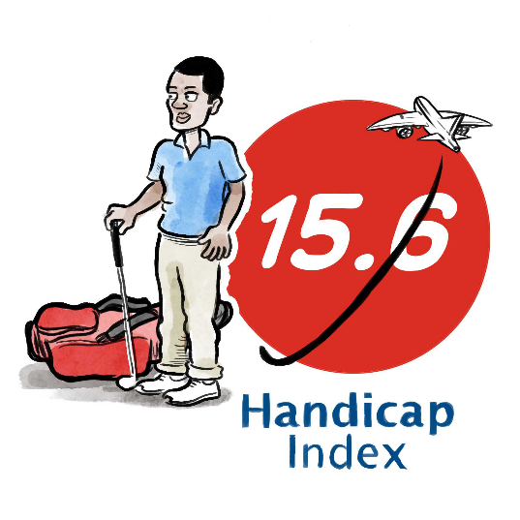
Purpose of the World Handicap System
The World Handicap System includes the Rules of Handicapping and the Course Rating System. Its purpose is to enable as many golfers as possible the opportunity to:
Obtain and maintain a Handicap Index,
Use their Handicap Index on any golf course around the world, and
Compete, or play recreationally, with anyone else on a fair basis.
Notes:
This is an opportunity to stress 3 aspects of the key principles of the WHS:
A system that is as INCLUSIVE and welcoming as possible – to make it as easy as possible for golfers to obtain and maintain a handicap
A system which gives golfers worldwide a handicap which is PORTABLE, from course to course and country to country
A system which calculates handicaps worldwide CONSISTENTLY and enables golfers from all over the world to be able to come together and play on a fair basis.
Ultimately, a World Handicap System is good for the already global game of golf.

Slide 6

World Handicapping
What’s new…
World Handicapping
What’s new…

Slide 7
Handicapping Rule Changes
Handicapping Rule Changes
There are twelve significant changes to the Handicap System coming in 2020
The main goal is to be:
Inclusive
Consistent
Modern
Notes:
Overall, there are five significant changes to the Handicap Index calculation that you’ll see in 2020. We’ll get into each one individually, but keep in mind that the overall goal of the calculation is to be inclusive, modern and consistent – all while making the lives of handicap committees and golf administrators a little easier. BONUS FOR EXCELLENCE
Minimum number of scores required to get a handicap – three 18-hole scores.
We’ll be using 8 differentials out of 20 the calculate the Handicap Index.
We’re introducing a Playing Conditions Calculation to account for variations in weather and course set up.
There’s a new Exceptional Score Reduction that looks at all posted scores.
Lastly, we’re introducing a Soft Cap and Hard cap to limit extreme upward movement of a Handicap Index.

Slide 8
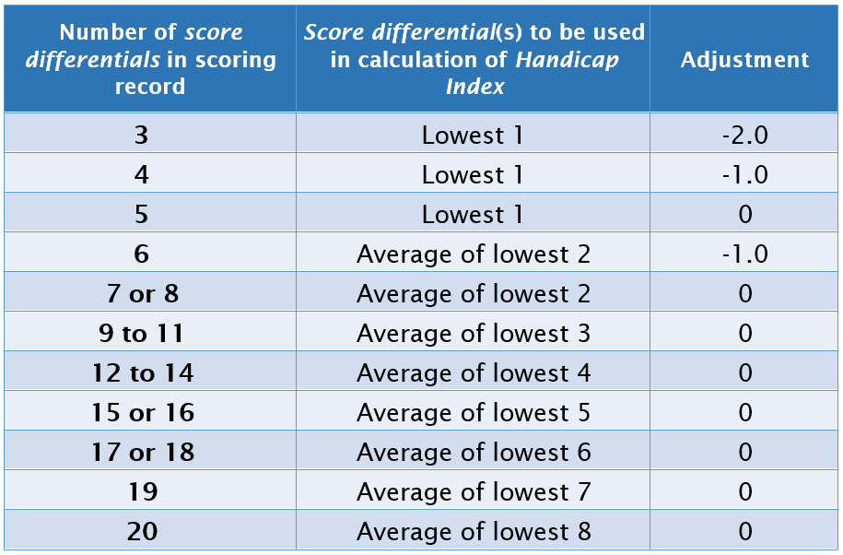
Handicap Index now uses 8 of most recent 20 Differentials
Handicap Index now uses 8 of most recent 20 Differentials
The following table will be used to determine the number of score differentials used in the Handicap Index calculation, as well as any additional adjustment:
Notes:
While we are being more inclusive to new golfers by reducing the minimal number of scores from 5 to 3, we’ve added a third column, which includes a downward adjustment as a safeguard to ensure that the field is still protected from player’s who have a minimal number of scores in their record. This happens when there are 3, 4, or 6 scores in a player’s scoring record. The adjustment reappears at 6 because that’s when an average of the lowest two scores is used.
This is done for a couple reasons. First, with limited scoring information available, a downward adjustment is necessary to project the player’s ability. A player typically plays to their ability one out of every five rounds. When only three scores exist, it’s possible that the player hasn’t yet played to their potential. Second, the adjustment takes place as a safeguard. We’re using less data to calculate the player’s Handicap Index, so we want to be sure to protect the field whose handicaps are calculated using a more robust scoring record.

Slide 9
Sample Calculation
USGA Handicap System: 12.9
World Handicap System: 13.3
Notes:
In this instance, 10/20 with .96 and 8/20 result in an increase of .4 strokes. This will not be the case for all golfers. While the impact to Handicap Index for most golfers will be minimal, the amount of change will depend on the handicap of the player (low, mid, high) and whether the player’s scores are consistent or volatile.
It’s important to note here as well that a player will not have to start anew for the WHS – scoring records will be carried over and will be calculated under the WHS formula in January 2020.

Slide 10
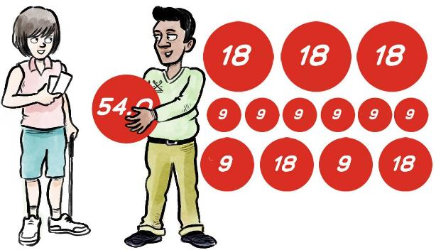
Minimum Scores to Obtain a Handicap Index
Minimum Scores to Obtain a Handicap Index
54 holes made up of any combination of 9- or 18-hole rounds.
No time limit on completing the submission of these scores.
Strong recommendation that initial scores are submitted hole-by-hole to better assess the potential of the player.
Notes:
Currently, the USGA Handicap System requires five 18-hole scores before a player can be issued a Handicap Index.
An overarching theme of the World Handicap System is to become more inclusive – and this feature will hopefully encourage golfers who only play sporadically to establish and maintain a Handicap Index.
It will be strongly recommended that a player’s initial three scores should be submitted hole-by-hole to enable clubs to better assess the player’s potential.

Slide 11
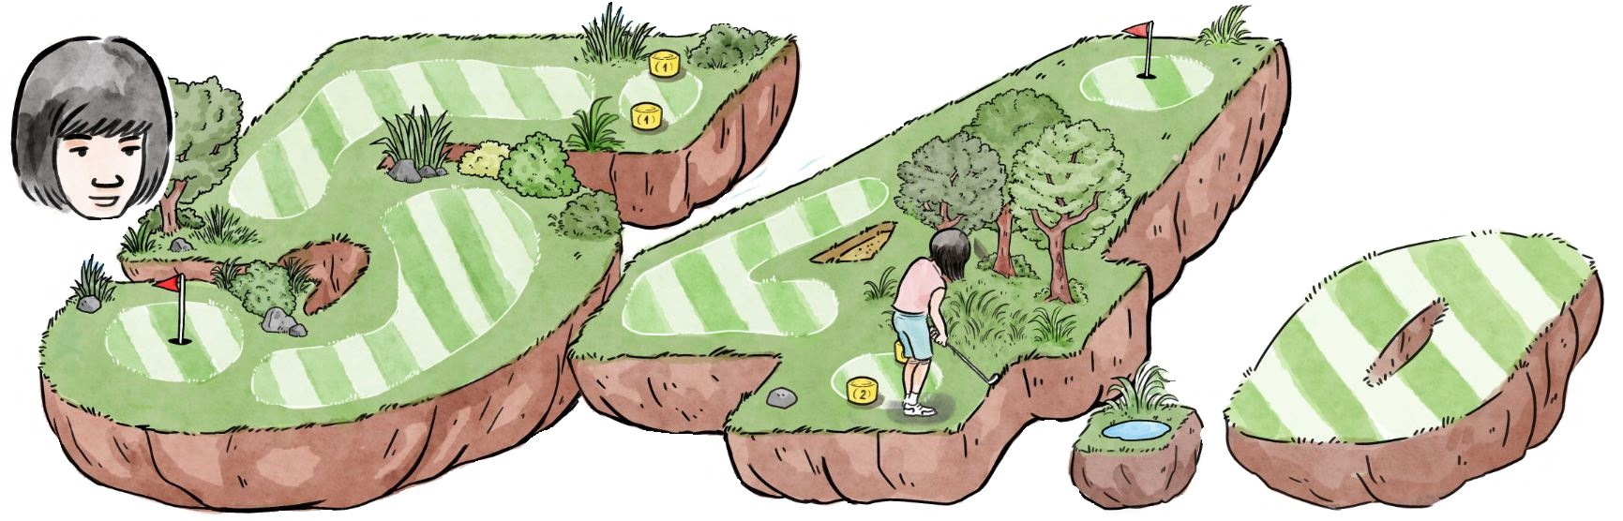
Maximum Handicap Index
Maximum Handicap Index
The maximum Handicap Index that can be allocated to a golfer is 54.0.
This speaks to two key principles of the World Handicap System.
To be as inclusive and accessible as possible.
To make it as easy as possible for golfers to obtain and maintain a Handicap Index.
Notes:
There are high handicap golfers on golf courses today. Providing these golfers with the Handicap Index they truly need will help them:
Better track their progress.
Stay motivated.
Have more fun.
Keep playing.

Slide 12
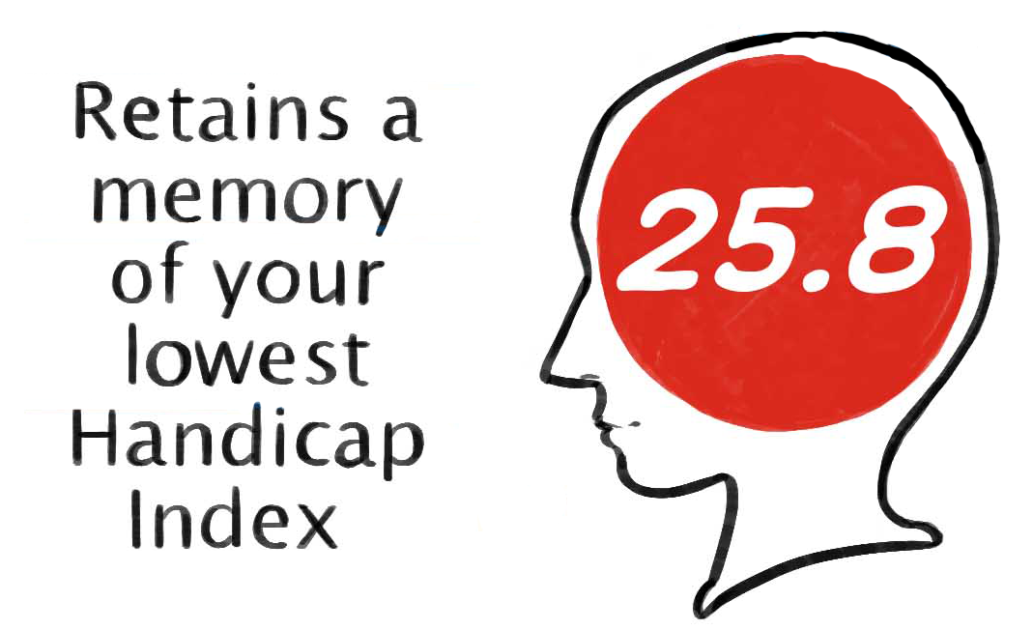
Low Handicap Index
Low Handicap Index
The Low Handicap Index represents the demonstrated ability of a player over the 12-month period preceding the most recent score in the player’s scoring record and provides a reference point against which the current Handicap Index can be compared.
A Low Handicap Index is established once a player has at least 20 acceptable scores in their scoring record. It is re-evaluated every time a new acceptable score is submitted.
A player’s scoring record must display their Low Handicap Index.
If a handicap committee reduces a player’s Handicap Index, the adjusted Handicap Index resets the Low Handicap Index to the adjusted Handicap Index, unless a Low Handicap index is already a lower number.
Notes:
A Low Handicap Index is established once a player has at least 20 acceptable scores in their scoring record. It is re-evaluated every time a new acceptable score is submitted.
A newly-determined Low Handicap Index is considered in the processing of the player’s next acceptable score whenever the next round is submitted. A player’s Low Handicap Index may become more than 12 months old in the period between two rounds being played (this is referenced in bullet points on slide and in Rule 5.8).
Where a Committee applied adjustment increases, the adjusted Handicap Index resets the Low Handicap Index at that level.
Where a Committee applied adjustment reduces a player’s Handicap Index, the adjusted Handicap Index resets the Low Handicap Index at that level unless a lower Handicap Index is still eligible.
A player’s scoring record must display their Low Handicap Index.

Slide 13
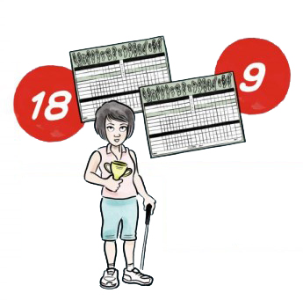
18 Hole Handicap Indexes Only
18 Hole Handicap Indexes Only
The new Rules of Handicapping do not calculate 9 hole Handicap Indexes.
Every golfer in the system will be issued an 18 hole Handicap Index.
18 Hole Indexes are valid for the purpose of calculating a 9 hole Course Handicap when a player is competing on a nine hole rated course.
One-half of the 18 hole index should be used when calculating a 9 hole Course Handicap.
Current 9 hole index members will have their scoring record converted to 18 hole scores and issued an 18-hole index during the transition to WHS
Notes:
There are high handicap golfers on golf courses today. Providing these golfers with the Handicap Index they truly need will help them:
Better track their progress.
Stay motivated.
Have more fun.
Keep playing.

Slide 14
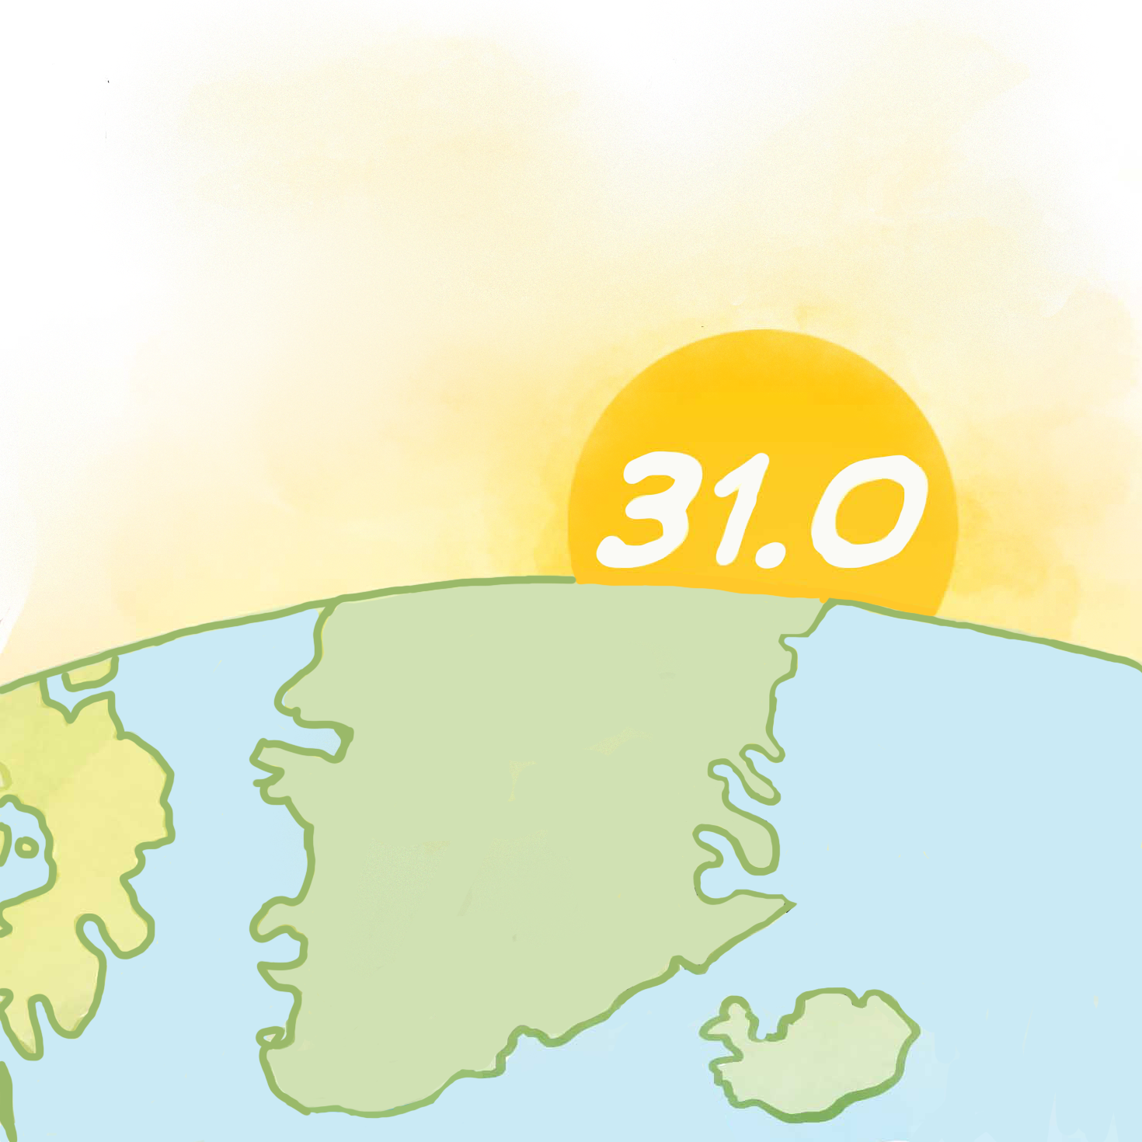
Daily Revisions
Daily Revisions
Under the Rules of Handicapping, a Handicap Index will update the day after a score(s) is posted.
Players should submit their scores as soon as possible after the round is completed, and before midnight.
This is to ensure the score will be used for the Playing Conditions Calculation.
A player’s Handicap Index can also be revised by a Committee adjustment.
Notes:
When a player doesn’t post a score, their Index won’t need an update – so just to be clear on this one, an update will take place whenever a player posts a score.
Revisions will take place at midnight following the submission of a score.
This is not a real-time revision. In other words, if someone plays twice in one day, their Handicap Index will still only update once on the following day.
For running multi-day competitions – The Committee can choose to use the Index at start of the competition or use the updated Index for each round. If using the same Index for the duration of the competition, scores would still need to be submitted daily.

Slide 15
Maximum Score for Handicap Purposes
Maximum Score for Handicap Purposes
Why maximum scores? | The Rules of Handicapping specify a maximum hole score for handicap purposes, ensuring bad holes don’t impact a player’s handicap too severely.
What is the maximum score? | Net Double Bogey
 | Net Double Bogey
Notes:
Even the best golfers have bad holes
The occasional bad hole shouldn’t define (reflect) a player’s ability
The maximum hole score ensures that the bad holes don’t impact a player’s Handicap Index too severely.
This presents a significant change to golfers in the U.S., where we are moving from the current Equitable Stroke Control procedure to Net Double Bogey.

Slide 16
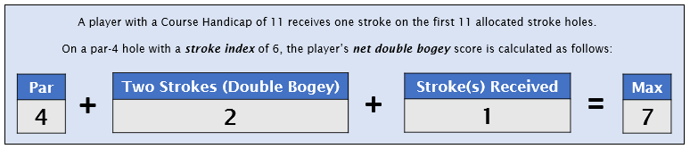
Maximum Score for Handicap Purposes
Net double bogey
=
Par
+
2
+/-
Handicap strokes received
or given on a hole
Notes:
Read through the example.

Slide 17
Application of Net Double Bogey Adjustment
Sunnyside Golf Club
Bronze Tees Course Rating: 72.1 Slope Rating: 122
Name of Player: Janet Smith
Course Handicap: 18
Hole | 1 | 2 | 3 | 4 | 5 | 6 | 7 | 8 | 9 | Out
Par | 4 | 4 | 5 | 4 | 3 | 5 | 4 | 5 | 3 | 37
S.I. | 7 | 13 | 3 | 9 | 15 | 1 | 11 | 5 | 17
Score | 5 | 5 | 6 | 5 | 4 | 6 | 5 | 6 | 4 | 46
Hole | 10 | 11 | 12 | 13 | 14 | 15 | 16 | 17 | 18 | In | Total
Par | 4 | 4 | 3 | 5 | 4 | 3 | 5 | 4 | 4 | 36 | 73
S.I. | 8 | 12 | 18 | 4 | 10 | 16 | 2 | 6 | 14
Score | 5 | 5 | 4 | 6 | 5 | 4 | 7 | 8 | 5 | 49 | 95

Slide 18
Application of Net Double Bogey Adjustment
Sunnyside Golf Club
Bronze Tees Course Rating: 72.1 Slope Rating: 122
Name of Player: Janet Smith
Course Handicap: 18
Hole | 1 | 2 | 3 | 4 | 5 | 6 | 7 | 8 | 9 | Out
Par | 4 | 4 | 5 | 4 | 3 | 5 | 4 | 5 | 3 | 37
S.I. | 7 | 13 | 3 | 9 | 15 | 1 | 11 | 5 | 17
Score | 5 | 5 | 6 | 5 | 4 | 6 | 5 | 6 | 4 | 46
Hole | 10 | 11 | 12 | 13 | 14 | 15 | 16 | 17 | 18 | In | Total
Par | 4 | 4 | 3 | 5 | 4 | 3 | 5 | 4 | 4 | 36 | 73
S.I. | 8 | 12 | 18 | 4 | 10 | 16 | 2 | 6 | 14
Score | 5 | 5 | 4 | 6 | 5 | 4 | 7 | 8 | 5 | 49 | 95
7 = Net double bogey adjustment of -1
Notes:
Adjusting a hole score for net double bogey can be done either:
Automatically, when hole-by-hole score entry is used, or
By the player, when submitting an adjusted gross score for the round

Slide 19
Application of Net Double Bogey Adjustment
Sunnyside Golf Club
Bronze Tees Course Rating: 72.1 Slope Rating: 122
Name of Player: Janet Smith
Course Handicap: 18
Hole | 1 | 2 | 3 | 4 | 5 | 6 | 7 | 8 | 9 | Out
Par | 4 | 4 | 5 | 4 | 3 | 5 | 4 | 5 | 3 | 37
S.I. | 7 | 13 | 3 | 9 | 15 | 1 | 11 | 5 | 17
Score | 5 | 5 | 6 | 5 | 4 | 6 | 5 | 6 | 4 | 46
Score for Competition = 95
Score for Handicap Purposes = 94
Hole | 10 | 11 | 12 | 13 | 14 | 15 | 16 | 17 | 18 | In | Total
Par | 4 | 4 | 3 | 5 | 4 | 3 | 5 | 4 | 4 | 36 | 73
S.I. | 8 | 12 | 18 | 4 | 10 | 16 | 2 | 6 | 14
Score | 5 | 5 | 4 | 6 | 5 | 4 | 7 | 8 | 5 | 49 | 95
94
7 = Net double bogey adjustment of -1

Slide 20
Guidelines for Most Likely Score
Guidelines for Most Likely Score
When a player starts, but does not complete a hole, the score recorded for handicap purposes is the Most Likely Score.
The Rules of Handicapping includes the following guidelines for determining a most likely score:
Position of the ball: | Strokes to be added:
On the putting green within 5 feet of the hole | Add 1 additional stroke
Between 5 feet and 20 yards from the hole | Add 2 or 3 additional strokes, depending on the position of the ball, the difficulty of the green and the ability of the player
Beyond 20 yards from the hole | Add 3 or 4 additional strokes, depending on the position of the ball, the difficulty of the green and the ability of the player
Notes:
The most likely score guidelines will provide more consistency for score posting in match play and other formats where player’s pick up but can still record an acceptable score. This takes some of the subjectivity out of making these determinations.

Slide 21
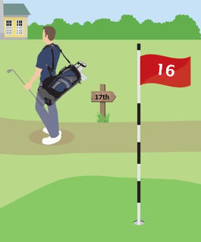
Hole Not Played
Hole Not Played
When a player does not play a hole, the score recorded for handicap purposes is net par.
For example:
A hole being declared out of play by the Committee for maintenance or reconstruction purposes.
Notes:
The procedure for posting a score for a hole not played remains the same with a new name. Par plus is now called net par.

Slide 22
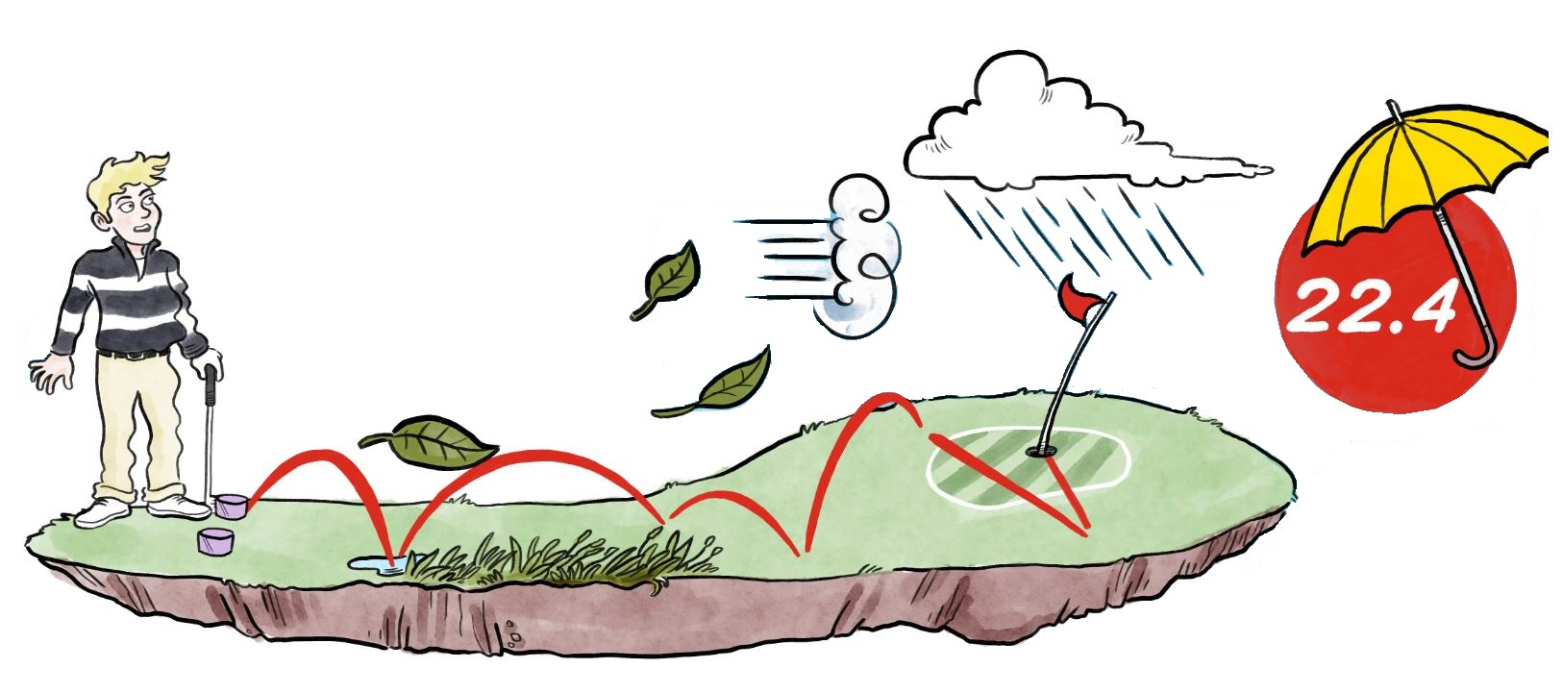
Playing Conditions Calculation
When adverse weather conditions or abnormal course set-up causes scores to be unusually high or low on a given day, a Playing Conditions Calculation will adjust Score Differentials to better reflect the player’s actual performance.
The ‘PCC’ will be simple and conservative in nature and will be adjusted in integer values.
-1, +1, +2, +3
A minus value means the course was playing easier than expected and will be added to the rating of the course in the differential calculation.
A plus value means the course was playing harder than expected and will be subtracted from the rating of the course in the differential calculation.
Notes:
Golf is an outdoor sport, and sometimes playing conditions can cause scores to be abnormally high or low on a given day. A score of 80 on a rainy, windy day or on a day where the course is set up more difficult than normal may be more impressive than a 79 on a calm day with normal course conditions.
The PCC will account for this and adjust Score Differentials to better reflect the player’s actual performance. Any adjustment will be clearly identified in the player’s scoring record for transparency. As noted on the slide, adjustments will be applied conservatively and will be in integer values; you won’t see an adjustment of +1.45.
The calculation will be automatic through the computation service. Also, the calculation will be purely data driven. The more posted scores which are above or below what is expected based on Course/Slope Ratings and Handicap Index of players, the more likely an adjustment will take place.
This feature is one of the more modern features of the system. It’s worked quite well in other parts of the world (Australia for example).

Slide 23
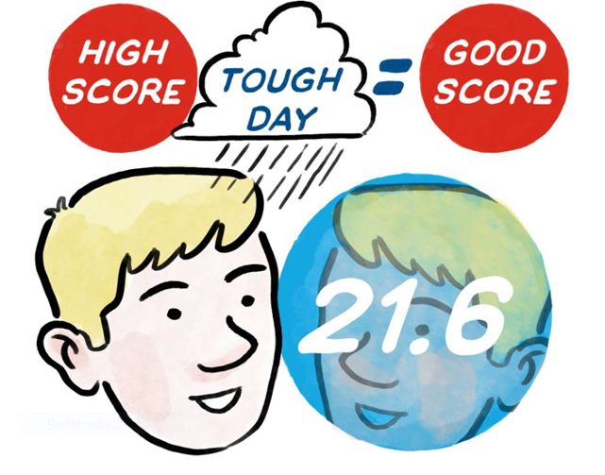
Playing Conditions Calculation
Is performed only once for a day. Considers acceptable scores submitted on a golf course, including all rated tees and both genders. Requires at least eight acceptable scores submitted by players with a Handicap Index of 36.0 or below. Is applied in the calculation of score differentials for all players. Includes both 9-hole and 18-hole acceptable scores.
Notes:
The PCC can also be used to indicate when the Course Rating of a golf course may need to be reviewed. If the PCC adjustment (which is conservative) is being applied 4-5 days a week, the Ratings may not be accurately reflecting the difficulty of the golf course, often due to issues with course setup.

Slide 24
Exceptional Score Reduction - ESR
Exceptional Score Reduction - ESR
ESR is a procedure for dealing with exceptional scores which may indicate the player’s true ability. The procedure considers all scores, rather than only Tournament scores.
How does it work?
Calculate Score Differential once score is posted and Playing Conditions Calculation is applied (when appropriate).
Calculate new Handicap Index.
If Score Differential is -7.0 strokes or better than the Handicap Index from when the round was played, apply ESR table reduction to new Handicap Index:
Score Differential Relative to Index | 7.0 – 9.9 strokes lower | 10.0+ strokes lower
ESR Adjustment | -1.0 | -2.0
This is in addition to any reduction caused by the score being used in the updated 8 of 20 calculation.
Notes:
The Exceptional Score Reduction is a procedure that will essentially replace the current 10-3 reduction process and will simplify the automatic reduction altogether.
ESR considers all scores, rather than just tournament scores, so that any time a player demonstrates ability that is significantly better than their Index suggests, a simple automatic adjustment is made.
If a player posts a score that produces a Score Differential 7.0 strokes or better than their Handicap Index at the time the score was submitted, an automatic adjustment is made using the displayed table.
When an Exceptional Score is posted, a -1 or -2 adjustment will be applied to each of the previous 20 score differentials in a player’s scoring record. The net result will be a 1.0 or 2.0 stroke reduction in their Handicap Index.
Subsequent scores posted will not contain the -1 or -2 adjustment, which allows the impact of the ESR to slowly reduce as new scores are posted.
It’ll be easier to explain not only how players get reduced– but also how posting scores will allow the reduction to naturally work itself out.

Slide 25
 | Date Played (dd/mm/yy) | Course Name | Course Rating | Slope Rating | Adjusted Gross Score | Score Differential | ESR Adjustment
1 | 9/29/20 | Hill CC | 70.5 | 125 | 92 | 19.4
2 | 9/22/20 | Hill CC | 70.5 | 125 | 91 | 18.5
3 | 9/5/20 | Hill CC | 70.5 | 125 | 75 | 4.1
4 | 9/1/20 | Hill CC | 70.5 | 125 | 99 | 25.8
5 | 8/28/20 | Hill CC | 70.5 | 125 | 89 | 16.7
6 | 8/23/20 | River CC | 71.3 | 127 | 92 | 18.4
7 | 7/26/20 | Meadow CC | 72.2 | 131 | 87 | 12.8
8 | 7/14/20 | Hill CC | 70.5 | 125 | 97 | 24.0
9 | 7/4/20 | Hill CC | 70.5 | 125 | 88 | 15.8
10 | 6/19/20 | River CC | 71.3 | 127 | 87 | 13.5
11 | 6/18/20 | Valley CC | 69.9 | 118 | 95 | 24.0
12 | 6/12/20 | Forest CC | 70.1 | 115 | 86 | 15.6
13 | 6/5/20 | Meadow CC | 72.2 | 131 | 85 | 11.0
14 | 6/2/20 | Hill CC | 70.5 | 125 | 82 | 10.4
15 | 5/30/20 | Hill CC | 70.5 | 125 | 94 | 21.2
16 | 5/25/20 | Valley CC | 69.9 | 118 | 89 | 18.3
17 | 5/22/20 | Hill CC | 70.5 | 125 | 75 | 4.1
18 | 4/29/20 | Hill CC | 70.5 | 125 | 85 | 13.1
19 | 4/14/20 | Hill CC | 70.5 | 125 | 93 | 20.3
20 | 4/10/20 | Hill CC | 70.5 | 125 | 94 | 21.2
21 | 4/3/20 | Meadow CC | 72.2 | 131 | 86 | 12.1
22 | 3/29/20 | Meadow CC | 72.2 | 131 | 84 | 10.2
23 | 3/27/20 | Hill CC | 70.5 | 125 | 92 | 19.4
24 | 3/22/20 | Valley CC | 69.9 | 118 | 90 | 19.2
25 | 3/21/20 | Hill CC | 70.5 | 125 | 89 | 16.7
 | Date Played (dd/mm/yy) | Course Name | Course Rating | Slope Rating | Adjusted Gross Score | Score Differential | ESR Adjustment
1 | 9/29/20 | Hill CC | 70.5 | 125 | 92 | 19.4
2 | 9/22/20 | Hill CC | 70.5 | 125 | 91 | 18.5
3 | 9/5/20 | Hill CC | 70.5 | 125 | 75 | 4.1
4 | 9/1/20 | Hill CC | 70.5 | 125 | 99 | 25.8
5 | 8/28/20 | Hill CC | 70.5 | 125 | 89 | 16.7
6 | 8/23/20 | River CC | 71.3 | 127 | 92 | 18.4
7 | 7/26/20 | Meadow CC | 72.2 | 131 | 87 | 12.8
8 | 7/14/20 | Hill CC | 70.5 | 125 | 97 | 24.0
9 | 7/4/20 | Hill CC | 70.5 | 125 | 88 | 15.8
10 | 6/19/20 | River CC | 71.3 | 127 | 87 | 13.5
11 | 6/18/20 | Valley CC | 69.9 | 118 | 95 | 24.0
12 | 6/12/20 | Forest CC | 70.1 | 115 | 86 | 15.6
13 | 6/5/20 | Meadow CC | 72.2 | 131 | 85 | 11.0
14 | 6/2/20 | Hill CC | 70.5 | 125 | 82 | 10.4
15 | 5/30/20 | Hill CC | 70.5 | 125 | 94 | 21.2
16 | 5/25/20 | Valley CC | 69.9 | 118 | 89 | 18.3
17 | 5/22/20 | Hill CC | 70.5 | 125 | 75 | 4.1 | -1
18 | 4/29/20 | Hill CC | 70.5 | 125 | 85 | 13.1 | -1
19 | 4/14/20 | Hill CC | 70.5 | 125 | 93 | 20.3 | -1
20 | 4/10/20 | Hill CC | 70.5 | 125 | 94 | 21.2 | -1
21 | 4/3/20 | Meadow CC | 72.2 | 131 | 86 | 12.1 | -1
22 | 3/29/20 | Meadow CC | 72.2 | 131 | 84 | 10.2 | -1
23 | 3/27/20 | Hill CC | 70.5 | 125 | 92 | 19.4 | -1
24 | 3/22/20 | Valley CC | 69.9 | 118 | 90 | 19.2 | -1
25 | 3/21/20 | Hill CC | 70.5 | 125 | 89 | 16.7 | -1
 | Date Played (dd/mm/yy) | Course Name | Course Rating | Slope Rating | Adjusted Gross Score | Score Differential | ESR Adjustment
1 | 9/29/20 | Hill CC | 70.5 | 125 | 92 | 19.4
2 | 9/22/20 | Hill CC | 70.5 | 125 | 91 | 18.5
3 | 9/5/20 | Hill CC | 70.5 | 125 | 75 | 4.1 | -1
4 | 9/1/20 | Hill CC | 70.5 | 125 | 99 | 25.8 | -1
5 | 8/28/20 | Hill CC | 70.5 | 125 | 89 | 16.7 | -1
6 | 8/23/20 | River CC | 71.3 | 127 | 92 | 18.4 | -1
7 | 7/26/20 | Meadow CC | 72.2 | 131 | 87 | 12.8 | -1
8 | 7/14/20 | Hill CC | 70.5 | 125 | 97 | 24.0 | -1
9 | 7/4/20 | Hill CC | 70.5 | 125 | 88 | 15.8 | -1
10 | 6/19/20 | River CC | 71.3 | 127 | 87 | 13.5 | -1
11 | 6/18/20 | Valley CC | 69.9 | 118 | 95 | 24.0 | -1
12 | 6/12/20 | Forest CC | 70.1 | 115 | 86 | 15.6 | -1
13 | 6/5/20 | Meadow CC | 72.2 | 131 | 85 | 11.0 | -1
14 | 6/2/20 | Hill CC | 70.5 | 125 | 82 | 10.4 | -1
15 | 5/30/20 | Hill CC | 70.5 | 125 | 94 | 21.2 | -1
16 | 5/25/20 | Valley CC | 69.9 | 118 | 89 | 18.3 | -1
17 | 5/22/20 | Hill CC | 70.5 | 125 | 75 | 4.1 | -1 / -1
18 | 4/29/20 | Hill CC | 70.5 | 125 | 85 | 13.1 | -1 / -1
19 | 4/14/20 | Hill CC | 70.5 | 125 | 93 | 20.3 | -1 / -1
20 | 4/10/20 | Hill CC | 70.5 | 125 | 94 | 21.2 | -1 / -1
21 | 4/3/20 | Meadow CC | 72.2 | 131 | 86 | 12.1 | -1 / -1
22 | 3/29/20 | Meadow CC | 72.2 | 131 | 84 | 10.2 | -1 / -1
23 | 3/27/20 | Hill CC | 70.5 | 125 | 92 | 19.4 | -1
24 | 3/22/20 | Valley CC | 69.9 | 118 | 90 | 19.2 | -1
25 | 3/21/20 | Hill CC | 70.5 | 125 | 89 | 16.7 | -1
 | Date Played (dd/mm/yy) | Course Name | Course Rating | Slope Rating | Adjusted Gross Score | Score Differential | ESR Adjustment
1 | 9/29/20 | Hill CC | 70.5 | 125 | 92 | 19.4
2 | 9/22/20 | Hill CC | 70.5 | 125 | 91 | 18.5
3 | 9/5/20 | Hill CC | 70.5 | 125 | 75 | 4.1 | -1
4 | 9/1/20 | Hill CC | 70.5 | 125 | 99 | 25.8 | -1
5 | 8/28/20 | Hill CC | 70.5 | 125 | 89 | 16.7 | -1
6 | 8/23/20 | River CC | 71.3 | 127 | 92 | 18.4 | -1
7 | 7/26/20 | Meadow CC | 72.2 | 131 | 87 | 12.8 | -1
8 | 7/14/20 | Hill CC | 70.5 | 125 | 97 | 24.0 | -1
9 | 7/4/20 | Hill CC | 70.5 | 125 | 88 | 15.8 | -1
10 | 6/19/20 | River CC | 71.3 | 127 | 87 | 13.5 | -1
11 | 6/18/20 | Valley CC | 69.9 | 118 | 95 | 24.0 | -1
12 | 6/12/20 | Forest CC | 70.1 | 115 | 86 | 15.6 | -1
13 | 6/5/20 | Meadow CC | 72.2 | 131 | 85 | 11.0 | -1
14 | 6/2/20 | Hill CC | 70.5 | 125 | 82 | 10.4 | -1
15 | 5/30/20 | Hill CC | 70.5 | 125 | 94 | 21.2 | -1
16 | 5/25/20 | Valley CC | 69.9 | 118 | 89 | 18.3 | -1
17 | 5/22/20 | Hill CC | 70.5 | 125 | 75 | 4.1 | -1 / -1
18 | 4/29/20 | Hill CC | 70.5 | 125 | 85 | 13.1 | -1 / -1
19 | 4/14/20 | Hill CC | 70.5 | 125 | 93 | 20.3 | -1 / -1
20 | 4/10/20 | Hill CC | 70.5 | 125 | 94 | 21.2 | -1 / -1
21 | 4/3/20 | Meadow CC | 72.2 | 131 | 86 | 12.1 | -1 / -1
22 | 3/29/20 | Meadow CC | 72.2 | 131 | 84 | 10.2 | -1 / -1
23 | 3/27/20 | Hill CC | 70.5 | 125 | 92 | 19.4 | -1
24 | 3/22/20 | Valley CC | 69.9 | 118 | 90 | 19.2 | -1
25 | 3/21/20 | Hill CC | 70.5 | 125 | 89 | 16.7 | -1
Note the scores made after the Exceptional Score will not have a -1 adjustment, which allows the ESR to take care of itself.
The player posted a second Exceptional Score on 9/5, which resulted in a -1 adjustment to their previous 20 differentials.
The player posted an Exceptional Score on 5/22, which resulted in a -1 adjustment to their previous 20 differentials.
Notes:
Go through the Exceptional Score Reduction example and how it applies to the exceptional score as well as the previous 19 score differentials. There can be multiple reductions if there are two score differentials 7.0 strokes or lower than the current Handicap Index.

Slide 26
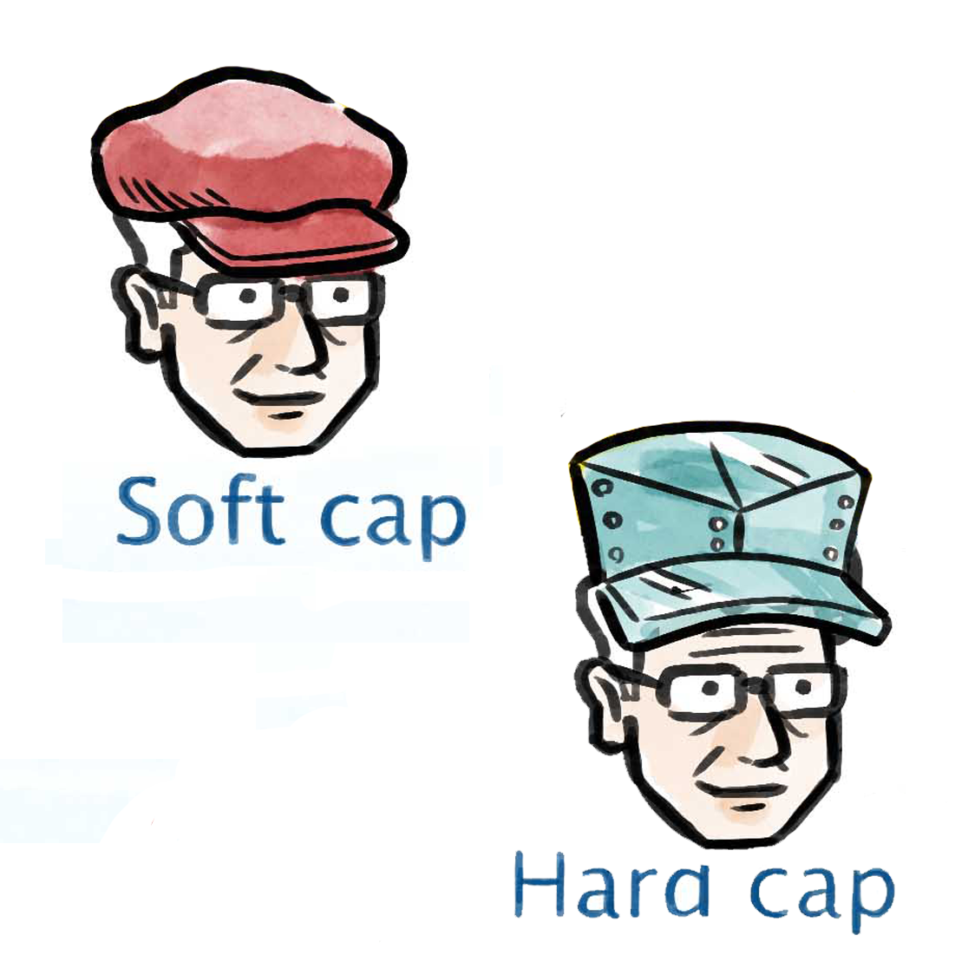
Handicap Index Caps
Handicap Index Caps
A Soft Cap and Hard Cap will be implemented to limit the extreme upward movement of a player’s Handicap Index within a 12-month period.
The Soft Cap will suppress upward movement by 50% after a 3.0 stroke increase over the Low Handicap Index has been reached.
The Hard Cap will restrict upward movement to 5.0 strokes over the Low Handicap Index.
The soft cap and hard cap procedures only start to take effect once a player has at least 20 acceptable scores in their scoring record.
Notes:
The soft cap and hard cap will be implemented to ensure that a temporary loss of form does not cause a player’s Handicap Index to move too far from a level consistent with their demonstrated ability. The caps also serve as anti-abuse safeguards and will aid in minimizing the potential for handicap manipulation. The Handicap Committee at the club will still play a key role and have the ability to allow a player’s Index to exceed the hard cap if special circumstances such as an injury exist.
Key points here:
This fixed limit will be incorporated into the system to eliminate the capacity for further, more extreme upward movement of a Handicap Index within a specified period of time.
This favors the consistent player. The volatile player will be impacted more often, which is a good feature for a handicap system to have.
A temporary loss of form should not cause a player’s Handicap Index to move too far from a level which is consistent with their underlying ability.
A low Handicap Index (or anchor) is part of the system and should be made visible to the player.

Slide 27
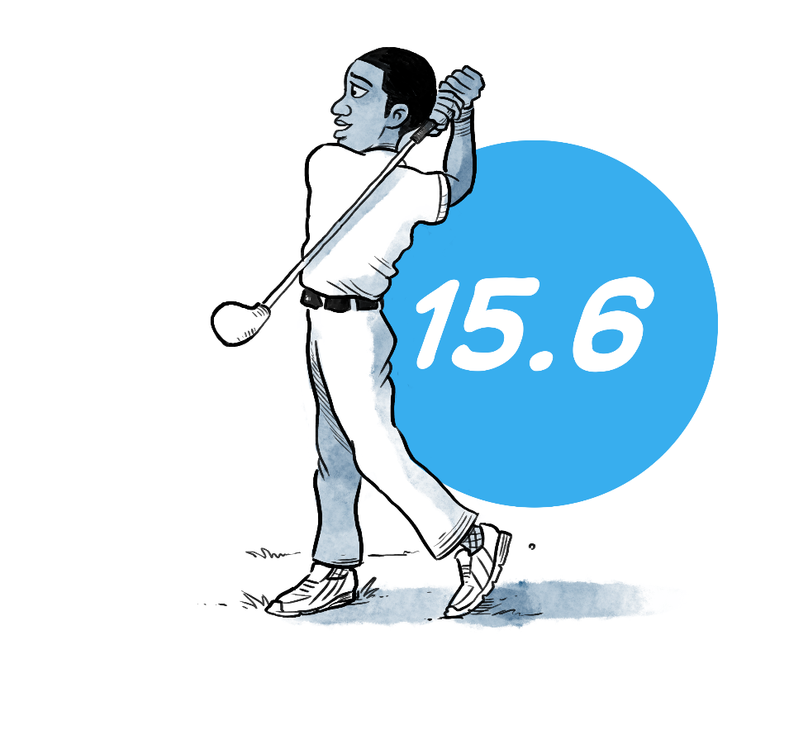
Course Handicap
Under the Rules of Handicapping, a Course Handicap will be the number of strokes a player receives to play down to the Par of the tees being played. The formula is:
11
Course Handicap =
(Handicap Index x Slope Rating / 113) + (CR – PAR)
Assume:
Course = Bushwood CC
Tee Rating = 66.4
Tee Slope = 132
Tee Par = 72
Handicap Index = 14.5
So:
14.5 x 132 / 113 = 16.9
Then:
66.4 – 72 = -5.6
Therefore:
16.9 + (-5.6) = 11.3 = 11
Notes:
By applying a Course Rating – Par adjustment, the process for setting up multi-tee events will be simplified – as this will eliminate the Section 3-5 adjustment. There is often confusion that comes along with the 3-5 adjustment, so this will be a welcomed change for many golfers out there.
Many golfers believe that their Course Handicap is relative to Par today – so while this is a significant change, it may be seen more intuitive to many.
It will be important that Par values are accurate – and this will be emphasized to clubs by AGAs – since Par will be used in the Course Handicap calculation and impact the score posted for Net Double Bogey and Net Par.

Slide 28
Playing Handicap
When handicap allowances are used in various formats of play, Course Handicaps are adjusted to make the competition equitable.
Within the Rules of Handicapping, the adjusted Course Handicap will be referred to as a Playing Handicap.
15
=
x .85
Playing Handicap = Course Handicap x Handicap Allowance
So:
14.5 x 132 / 113 = 16.9
Assume:
Course = Bushwood CC
Tee Rating = 66.4
Tee Slope = 132
Tee Par = 72
Handicap Index = 14.5
Four Ball = 85%
Then:
66.4 – 72 = -5.6
Therefore:
16.9 + (-5.6) = 11.3 = 11
= Course Handicap
Finally:
11.3 x .85 = 9.61 = 10
= Playing Handicap
Notes:
Note animation next to player: 15 x .85 = 13
There will need to be an adjustment when players compete from tees where Par is different – but this will happen much less frequently than players competing from tees with a different Course Rating.

Slide 29

QUESTIONS?
QUESTIONS?

Slide 30

World Handicapping
Posting Scores…
World Handicapping
Posting Scores…

Slide 31


Acceptability of Scores
Scores from an authorized format of play which meets all the provisions set out within the Rules of Handicapping (see Rule 2).
Scores in both match play and stroke play – including multi-ball or team competitions where players have not completed one or more holes or players are requested to pick up when out of contention on a hole.
Scores on all courses with a current Course Rating and Slope Rating made during an active season, both at home and away.
Notes:
Go through each type of acceptable score. Note that this does not present a change for golfers in the U.S.

Slide 32
Acceptability of Scores
Scores made under the Rules of Golf and The Modified Rules of Golf for Players With Disabilities.
When accompanied by at least one other person.
  When a player follows a Model Local Rule even if the Committee has not adopted it.
    For example – Alternative option to stroke and distance or preferred lies.

Slide 33


Unacceptable Scores
A score is not acceptable for handicap purposes and must not be posted to a player’s scoring record if a player has been disqualified from a competition for a breach of the Rules of Golf that might have provided the player with a significant advantage; e.g. using a non-conforming club.
Other examples:
Foursomes (also known as Alternate Shot)
Scrambles
When being trained or taught
Notes:
The Rules of Handicapping state the score is not acceptable if a breach resulting in a disqualification provided the player with a significant advantage. The score may be acceptable for some other situations where a player is disqualified - such as signing an incorrect scorecard.

Slide 34

Timeframe for Submitting a Score
Scores should be posted on the day of play and before midnight. Posting of scores using GHIN software are possible by three different methods:
The posting kiosk installed in the golf course pro shop, clubhouse or locker room
Using the GHIN Mobile App on a smartphone (Will eventually require the user to log in with profile credentials consisting of their email address and a password (available for iPhone or Android only)
Logging into the GHIN.com desktop dashboard on an internet connected computer, tablet or cell phone
(Will eventually require the user to log in with profile credentials consisting of their email address and a password)
Notes:
Emphasize the importance of posting as soon as possible after play. This will ensure the accuracy of a player’s Handicap Index on the next day-- and allow for the score to contribute to the data pool which determined if an adjustment for abnormal playing conditions should be made. More on this topic will be covered later in the presentation.

Slide 35
Score Type Designations
There are various score type designations defined in the World Handicapping System:
Golfer Designations:
Club Designations:
H = Home Score
H = Home Score
A = Away Score
A = Away Score
C = Competition
C = Competition
P = Penalty Score
System Designations:
N = Combined Score
E = Exceptional Score
Notes:
Emphasize the importance of posting as soon as possible after play. This will ensure the accuracy of a player’s Handicap Index on the next day-- and allow for the score to contribute to the data pool which determined if an adjustment for abnormal playing conditions should be made. More on this topic will be covered later in the presentation.

Slide 36
Treatment of 9-Hole Scores
9-hole scores are acceptable for posting when played on a rated 9-hole course
Two 9-hole scores are combined to create an 18-hole score differential.
9 + 9 =
18
The combined score will be denoted by the letter N
If only one 9-hole score differential is present in a player’s record, it will be displayed at the bottom of their scoring history. But, it will not be included in the Handicap Index until it is combined with a second 9-hole score.
Notes:
This does not present a change for golfers in the U.S.
Note that 9-hole scores are combined in the order they are received.
The minimum number of holes required for an 18-hole score will be 14, rather than the current number of 13 which presents minimal change.

Slide 37
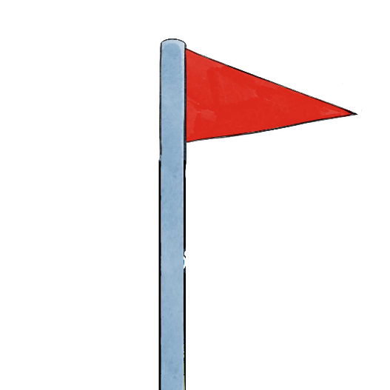
Fewer than 9 Holes Played
For a 9-hole score to be acceptable for handicap purposes, a minimum of 7 holes must be played.
If a player plays 7 or 8 holes, a 9-hole score will be produced by adding a score of Net Par for the remaining hole(s).
This 9-hole score must then be combined with another 9-hole score to produce an 18-hole score differential.
8 to 9
Notes:
This does not present a change for golfers in the U.S.
For a 9-hole score to be acceptable for handicap purposes, a minimum of 7 holes must be played.
A hole is deemed to have been played if the hole has been started.

Slide 38
Fewer than 18 Holes Played
For a 18-hole score to be acceptable for handicap purposes, a minimum of 14 holes must be played.
If a player plays 14 or more holes, an 18-hole score will be produced by adding a score of Net Par for the remaining hole(s).
If a player plays 10 to 13 holes, the player will record a 9-hole score only counting holes 1 thru 9 as their score, ignoring scores from holes 10 thru 13.
15 to 18
Notes:
This does not present a change for golfers in the U.S.
For a 9-hole score to be acceptable for handicap purposes, a minimum of 7 holes must be played.
A hole is deemed to have been played if the hole has been started.

Slide 39
Handicap Allowances
Handicap Allowances are recommended to provide equity for various forms of team competition.
Under the Rules of Handicapping, the allowance recommendations will be the same for men and women.
STROKE PLAY
Format: | Allowance:
Singles Stroke Play/Stableford | 95%
Four-ball Stroke Play | 85%
Maximum Score Form of Stroke Play | 95%
Best 1 of 4 Stroke Play | 75%
Best 2 of 4 Stroke Play | 85%
Best 3 of 4 Stroke Play | 100%
All 4 of 4 Stroke Play | 100%
Total Score of 2 | 100%
Foursomes | 50% combined
Selected Drive (Greensomes) | 60% Low + 40% High
Pinehurst/Chapman | 60% Low + 40% High
Scramble (4 players) | 25%/20%/15%/10% from lowest to highest handicap
Scramble (2 players) | 35% Low, 15% High
MATCH PLAY
MATCH PLAY
Format: | Allowance:
Head to Head | 100%
Four-ball | 90%
Total Score of 2 Match Play | 100%
Foursomes | 50% Combined
Selected Drive (Greensomes) | 60% Low + 40% High
Pinehurst/Chapman | 60% Low + 40% High
Notes:
While Handicap Allowances allow for equity in various formats of play, a player’s Handicap Index should be unaffected by the result of applying Handicap Allowances to a particular match or event.
They are no longer gender specific.
Handicap Allowances listed in the Rules of Handicapping are recommendations. They fall under Conditions of Competitions and are determined by the Committee in charge.
These allowances have been reviewed by the World Handicap Research Team and are set to allow for a top ten finish – not to win the competition.

Slide 40

Home Club
To ensure that a player has only one Handicap Index, and to easily identify the golf club or AGA with authority should issues arise, a player should have one Home Club.
A Home Club is determined by the player and is typically determined by where the player submits the most scores or demonstrates regularity of play.
The home club designation, however, is set by the club in the Admin Portal.
Should a dispute over a player’s Handicap Index or handicap status occur, the Home Club and the AGA of the home club have final jurisdiction.
Notes:
Multi-membership will continue, but each player will have only ONE Handicap Index and ONE scoring record.
Where a player is a member of more than one club, it must be clear which is the Home Club. This will allow clubs to work together on handicap related matters.

Slide 41
QUESTIONS?
QUESTIONS?

Slide 42

GHIN-2020
GHIN-2020
A modern cloud-based system for managing handicap data

Slide 43
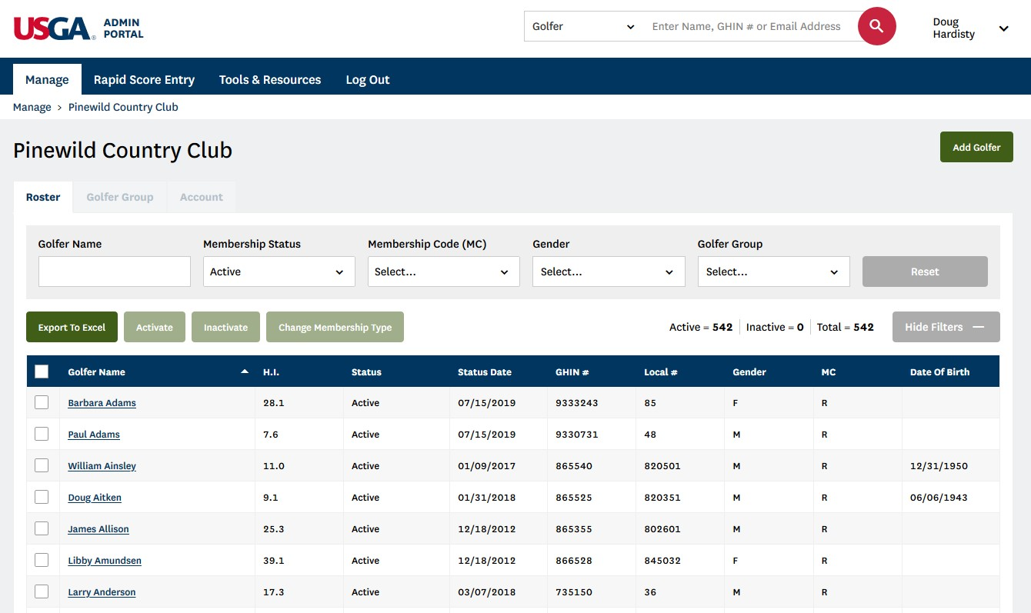
Handicap Administration
Association
Admin Portal
Club
Admin Portal

Slide 44
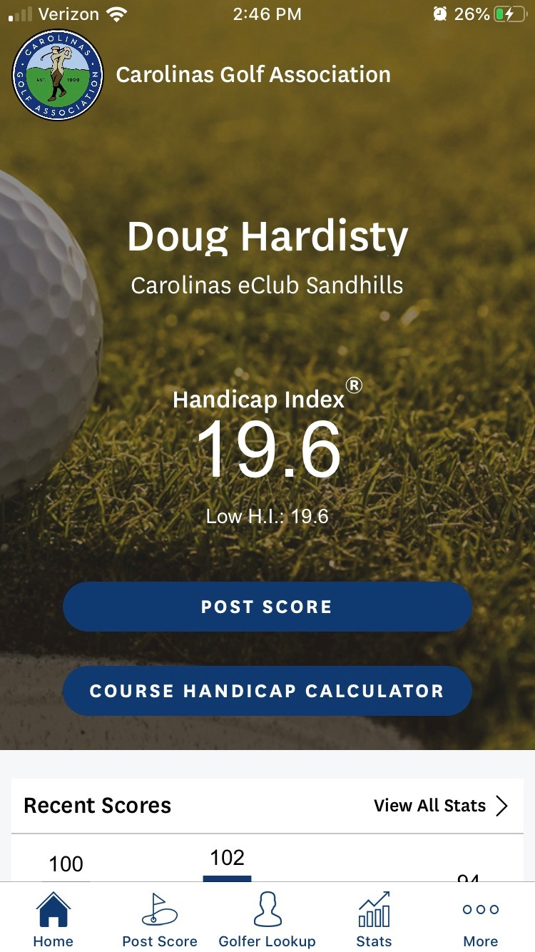
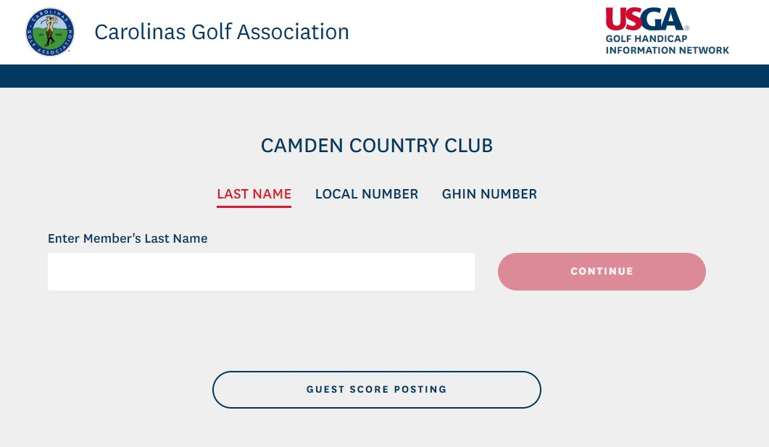

Golfer Products
Mobile App
Posting Kiosk
Desktop Dashboard

Slide 45
Mobile App Screenshots
Mobile App Screenshots
Home Screen

Slide 46
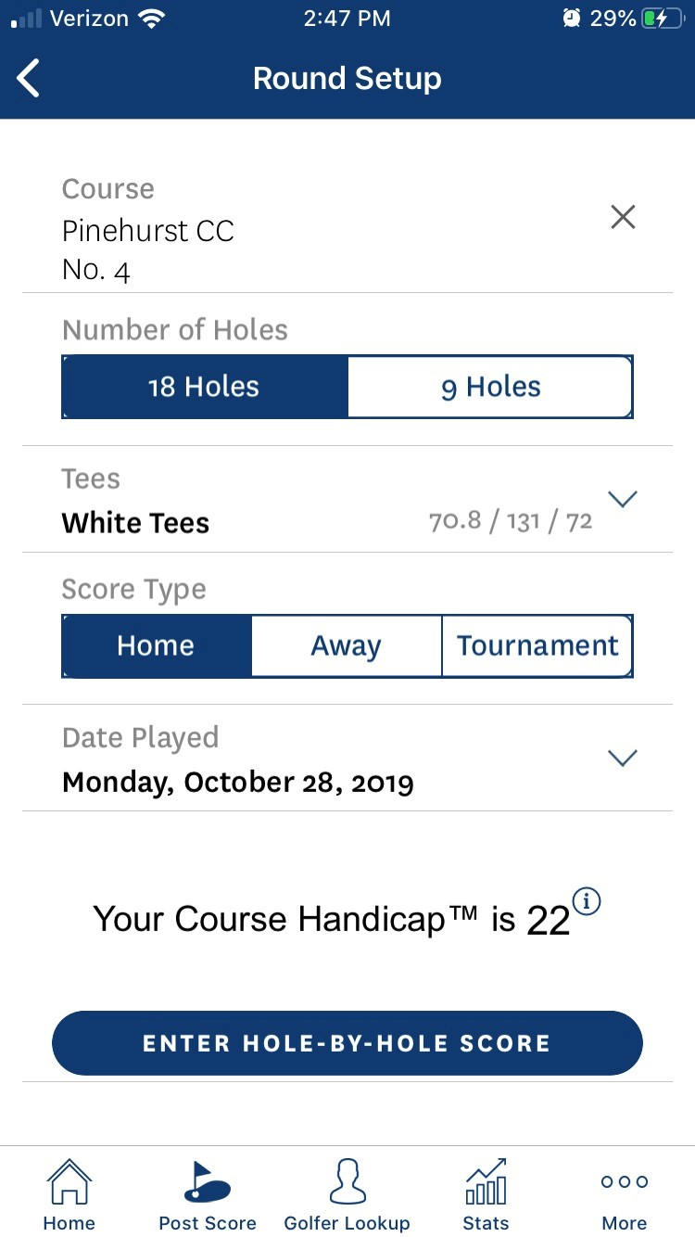
Mobile App Screenshots
Mobile App Screenshots
Entering Scores
Hole-by-Hole
Set-up

Slide 47
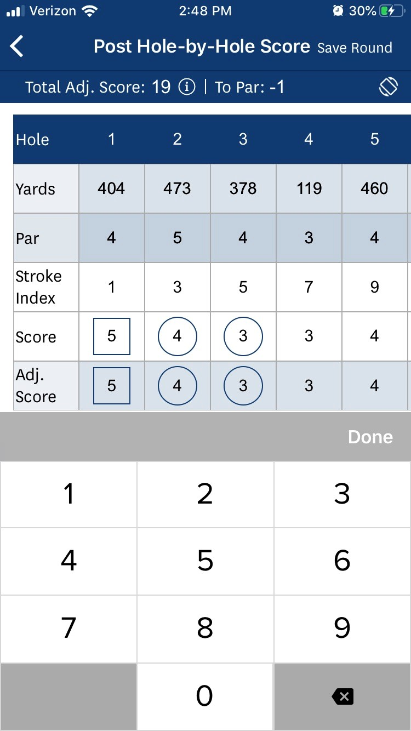
Mobile App Screenshots
Mobile App Screenshots
Entering Scores
Hole-by-Hole

Slide 48
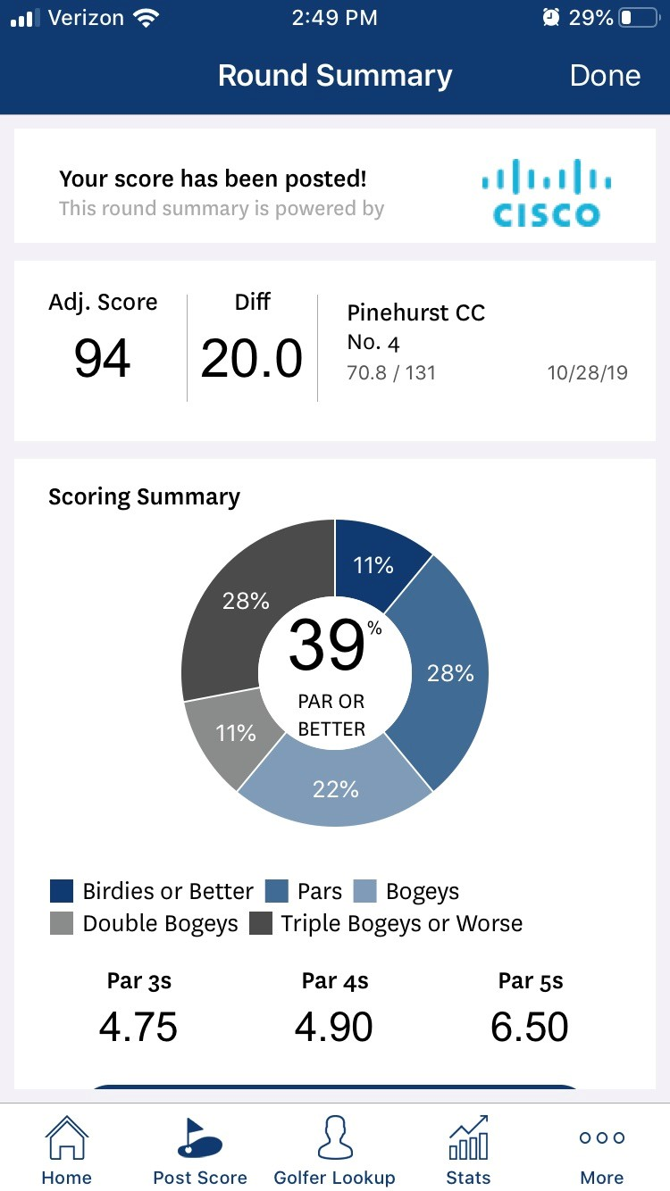
Mobile App Screenshots
Mobile App Screenshots
Entering Scores
Hole-by-Hole
Summary

Slide 49
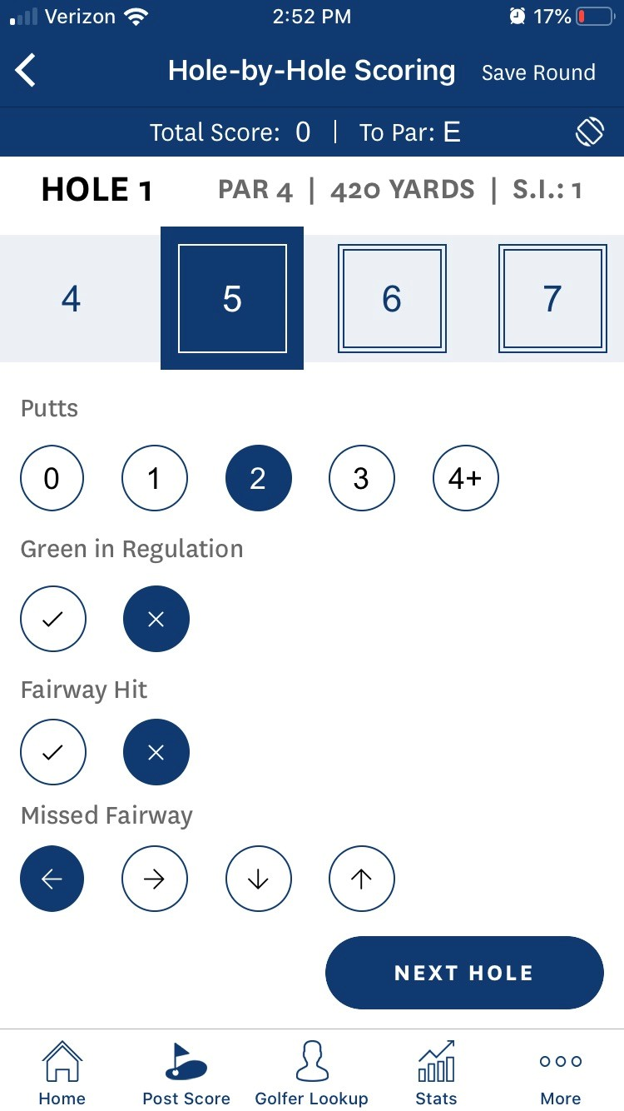
Mobile App Screenshots
Mobile App Screenshots
Entering Scores
Hole-by-Hole
Using Stats

Slide 50
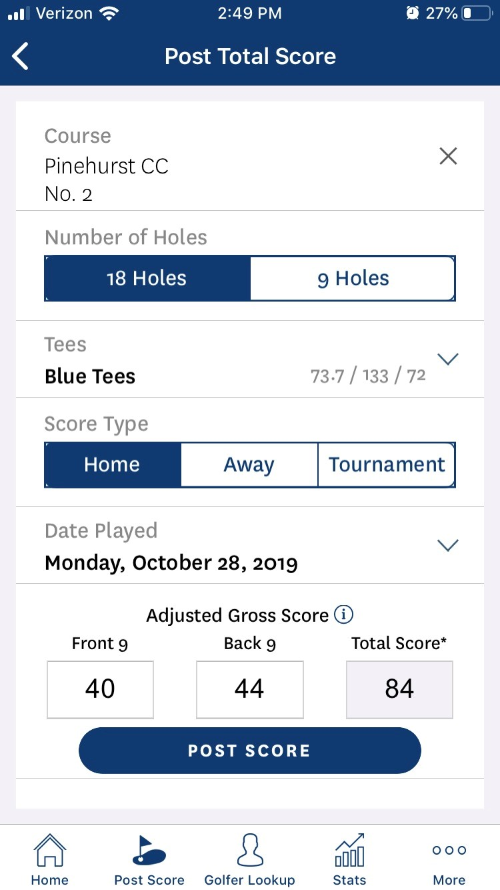
Mobile App Screenshots
Mobile App Screenshots
Entering Scores
Total Score

Slide 51
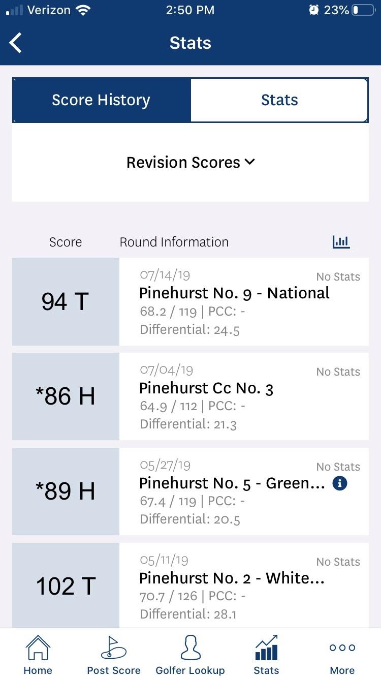
Mobile App Screenshots
Mobile App Screenshots
Scoring
History

Slide 52
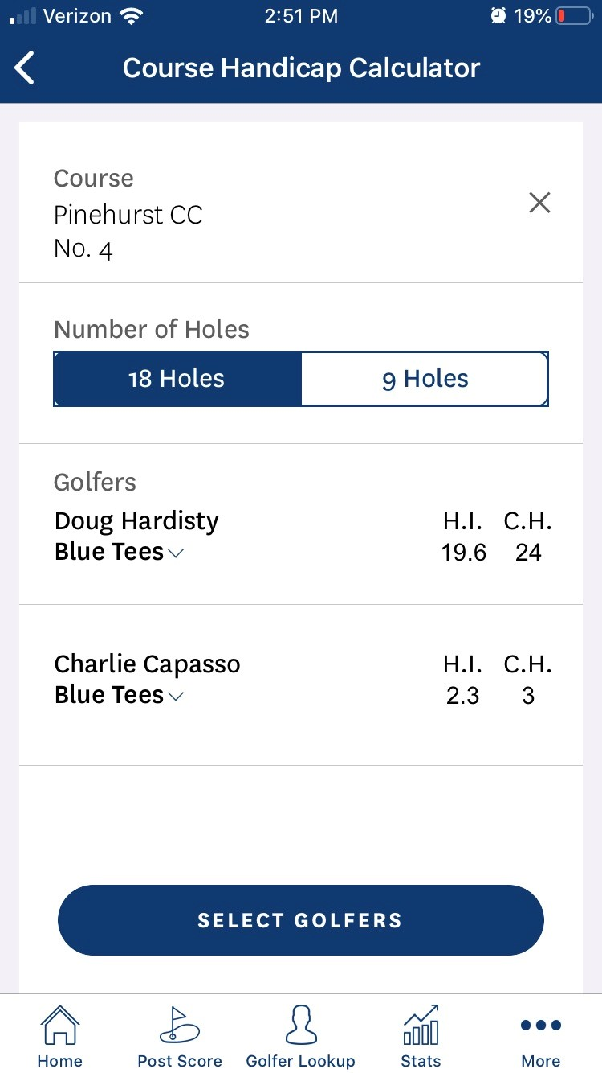
Mobile App Screenshots
Mobile App Screenshots
Handicap Calculator

Slide 53
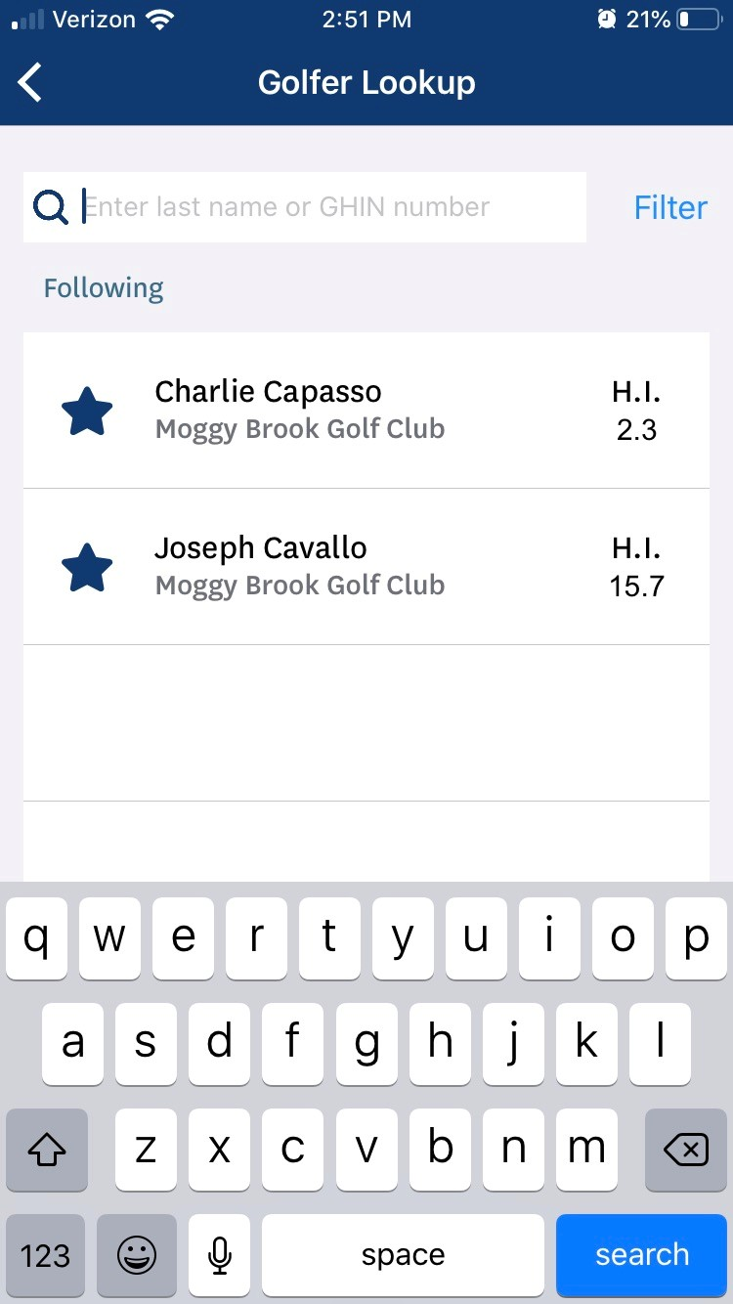
Mobile App Screenshots
Mobile App Screenshots
Golfer
Lookup &
“Following” Feature

Slide 54
Thank you for attending!
Notes:
Please use this closing slide if you do not plan to co-brand it.

